Slide 1

Group Member: - Syeda NoorJaha Azim (12101064) Razia Sultana (12101047) Tajul Islam (12101067) Arafat Habib (12101056) Abu Sufian (12101048) Md. Asif Ibtehaz (14341001)
OliGoli
CSE 470(Group01)

Slide 2
Introduction
Problems with existing system
Motivation
Benefits of the new system

Slide 3
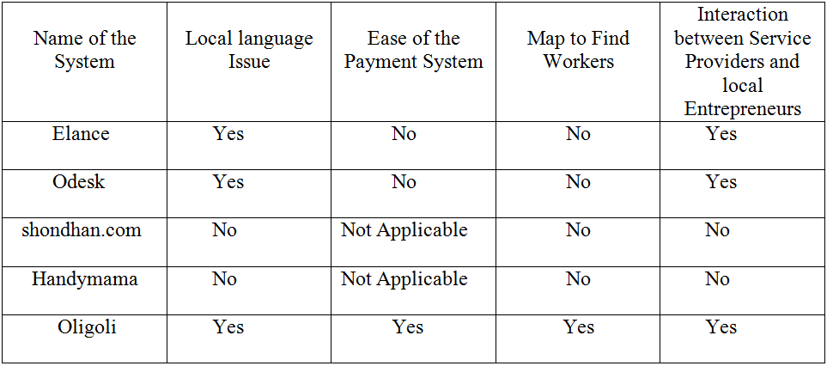
Background Study

Slide 4
Approach
Services provided by OliGoli
User benefit

Slide 5
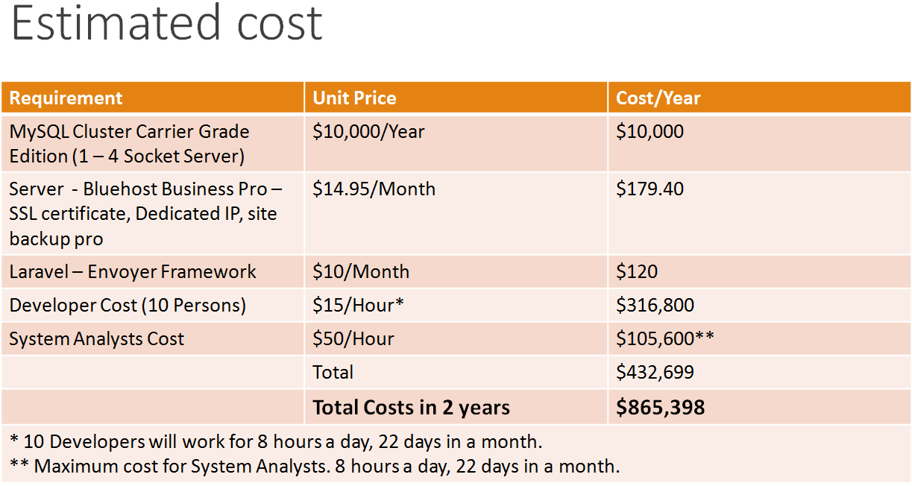
Cost and Benefit

Slide 6
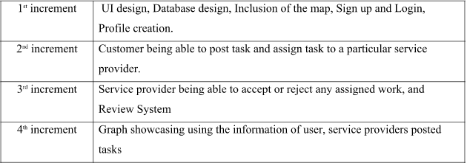
Methodology
Incremental method

Slide 7
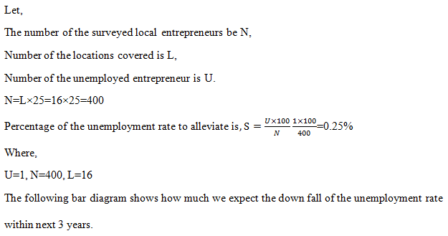
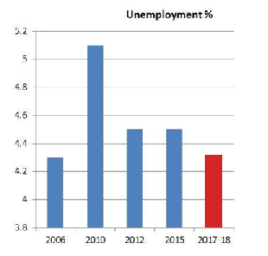
Experimental Study

Slide 8
Limitations and Future Work
Boundaries of the new System
Future of new system

Slide 9
Database

Slide 10
UI

Slide 11
Thank you

